Slide 1




Developing a multi-platform game using Unity
Submitted by
Andrei-Alin Sârbu
andr56f9@edu.zealand.dk
Under the suprvision of:
Ivan Rosenvinge Frederiksen
Department of Computer Science

Slide 2

Outline
Introduction
What is my motivation for the chosen project?
Method
Planning
Game preview and progress

Slide 3


Introduction
My project idea aims to develop an engaging mobile game using Unity. With a focus on captivating gameplay, seamless user experience, and effective marketing, I aim to create a successful game that attracts and retains players. Through thorough research, iterative design, and a data-driven approach, I strive to deliver a compelling gaming experience for our target audience while driving growth and monetization opportunities.

Slide 4

What is my motivation for the chosen project?
Cross-platform compatibility
Robust development tools
Large community and resources
Monetization opportunities
Fun and creative outlet

Slide 5
Method
My principal method to achieve the completion of this project will be researching. These are my follow-up criteria:
Genre-specific research;
User friendly interface;
Unity resources;
Clean and refactored code;
Easy for continuous development and adding new features.

Slide 6


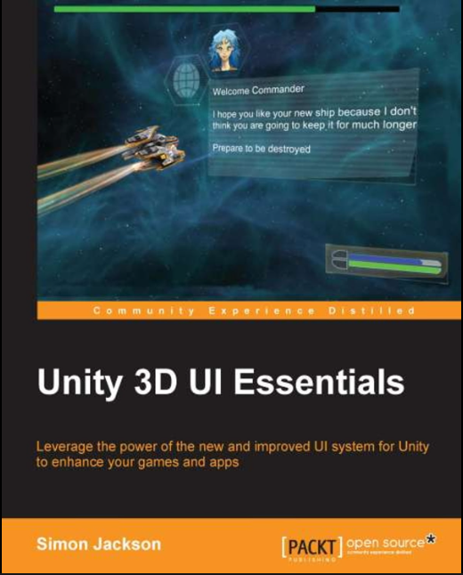
During my research I used a lot of online searching engines and what helped me the most were several video tutorials and the following books:
"Unity in Action: Multiplatform Game Development in C#" by Joe Hocking, 3rd edition, 2022 (fig. 1). I used this book for some advanced Unity development examples such as 3D camera control, 3D physics, sound effects and music.
“Unity 3D UI Essentials" by Simon Jackson, published in 2015 (fig. 2). I used this book also for some advanced programming examples for Unity that helped me out like player control and movement, 3D scenes and some layouts.

Slide 7
Planning
My plan will be based on some activities that I must do during the developing process:
Prototyping;
Iterative Design;
User Acquisition;
User Retention.

Slide 8
Game progress

Slide 9
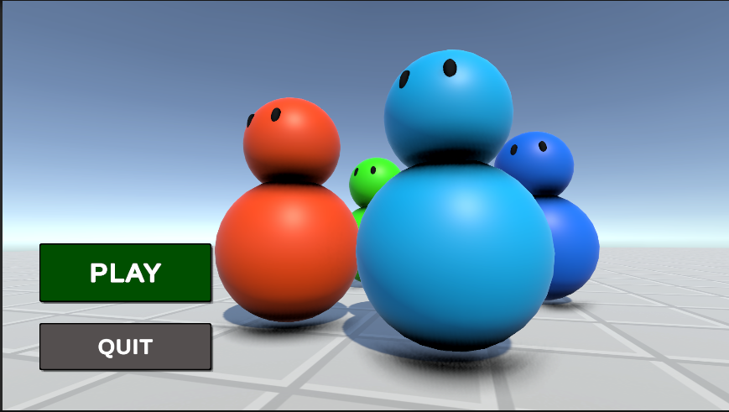

Slide 10



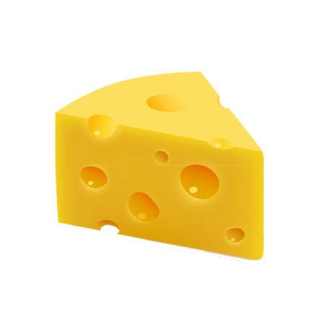

Mini Chef

Slide 11
Game description
You are a mini chef all alone in a chaos ridden kitchen. The orders are flooding and you’ve got to hurry up and serve your clients before you run out of time.
Your goal is to prepare as many high quality orders possible to achieve a high score.

Slide 12
Game developing progress in pictures

Slide 13
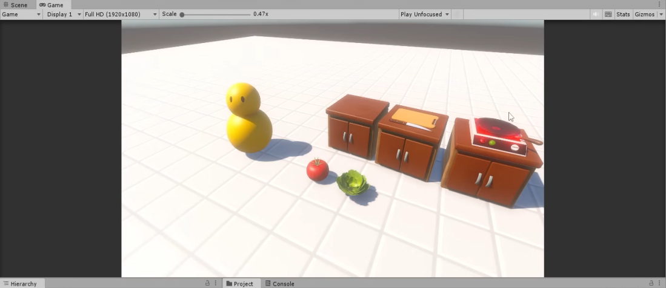
Fig. No. 1 – Early stages of the game, preparing the scene, layouts, and some 3D objects

Slide 14
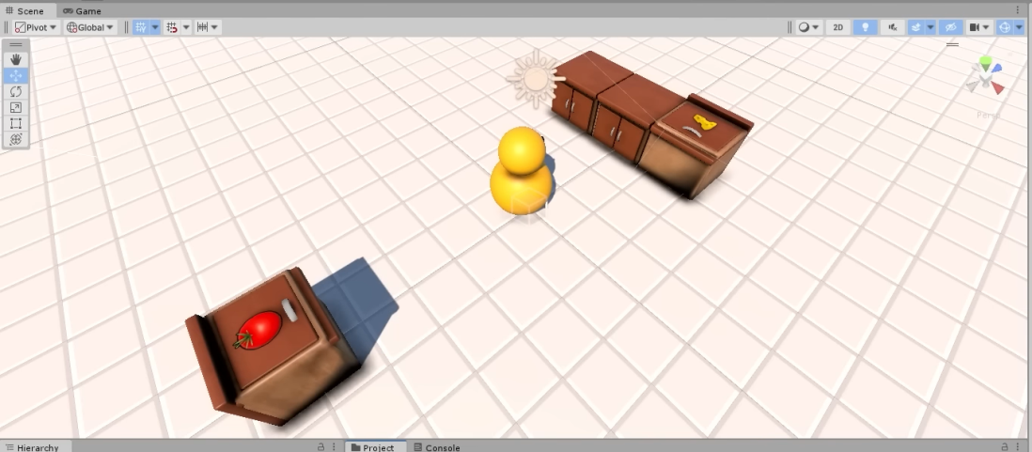
Fig. No. 2 – Player movement and control as well as placement of objects

Slide 15
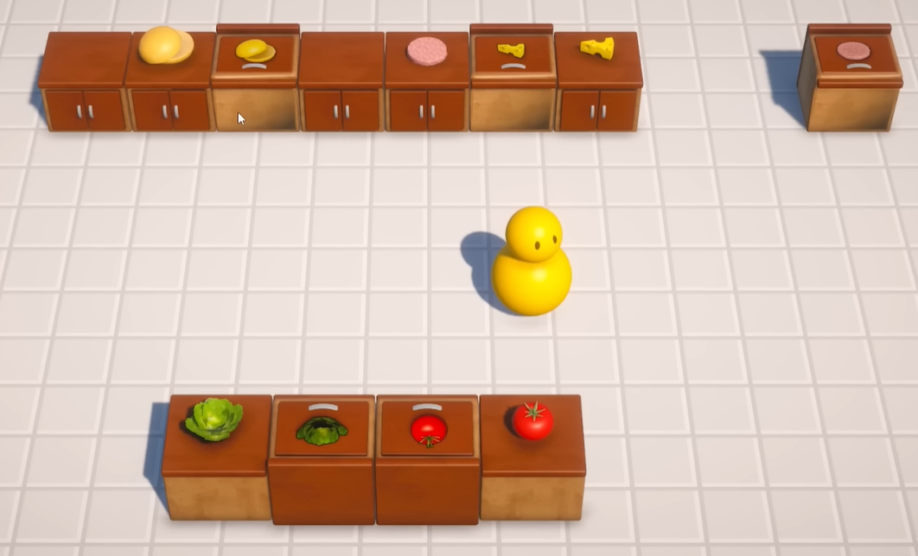
Fig. No. 3 – Mid game development process, scene starts to be clearer, the 3D objects are nice defined and placed also with some actions/attributes

Slide 16
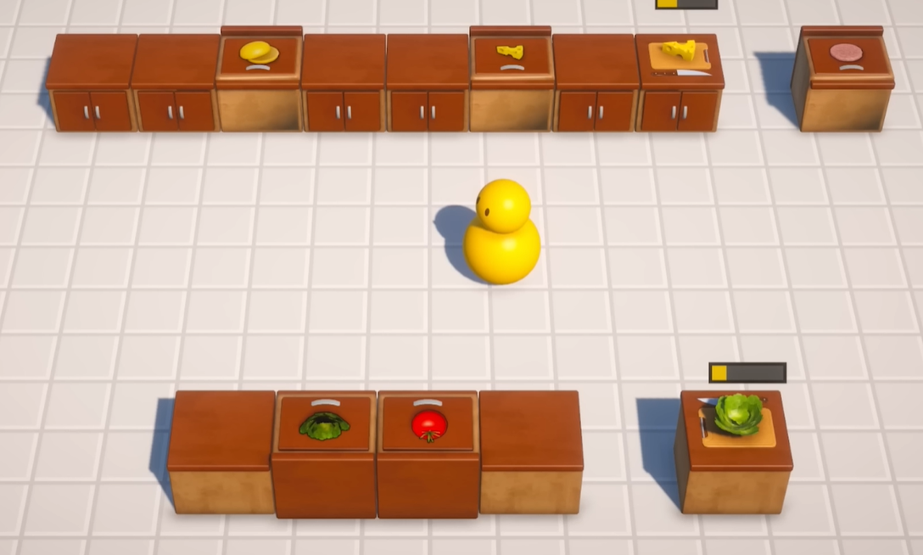
Fig. No. 4 – It is the 3rd figure but with some more code added that gives to few objects some special attributes

Slide 17
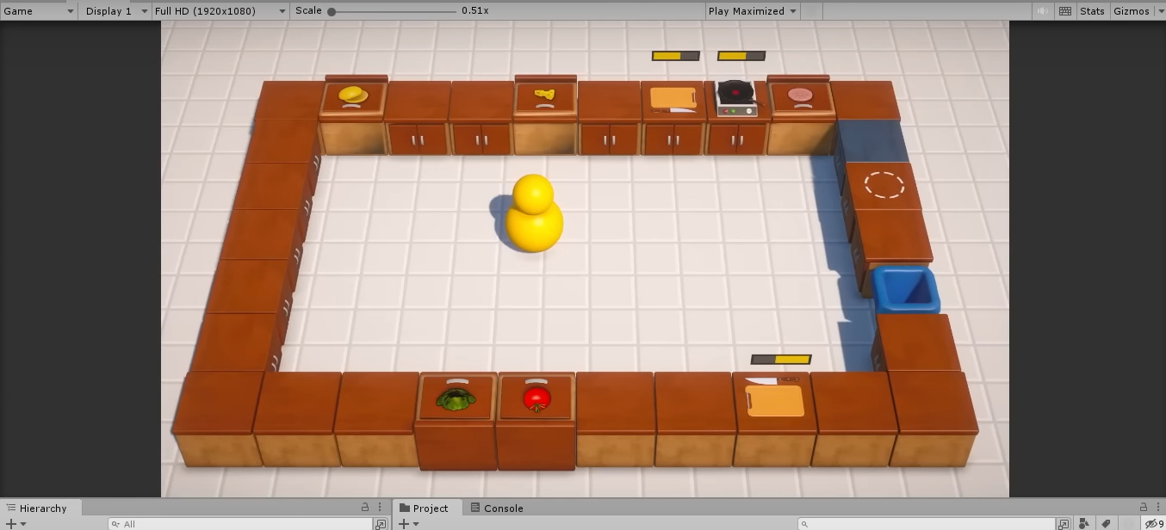
Fig. No. 5 – Scene is almost ready, everything is placed in order, player can move around and start learning the game

Slide 18
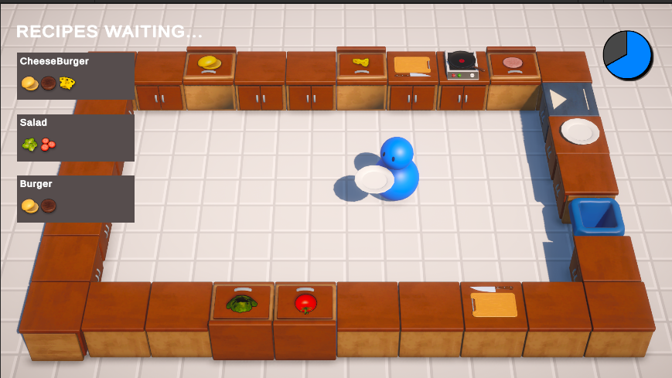
Fig. No. 6 – Game is almost done, now you have also the recipes messages that needs to be done so the player can easily learn what he must do

Slide 19
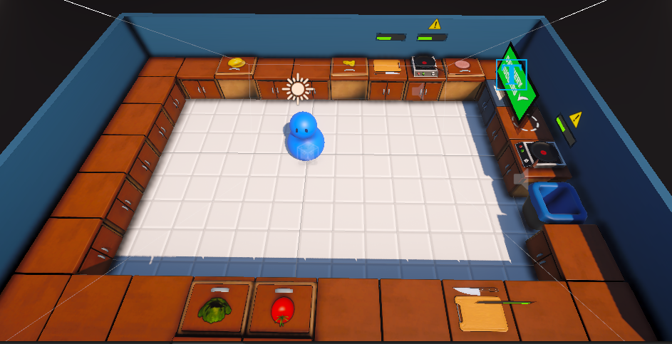
Fig. No. 7 – Fully implemented game

Slide 20
Thank you for your attention!

